Slide 1
Resonate: A Retrieval-Augmented Framework For Meeting Insight Extraction
Sartaj Bhuvaji (sbhuvaji@seattleu.edu), Seattle University
Prachitee Chouhan (pchouhan@seattleu.edu), Seattle University
Madhuroopa Irukulla (mirukulla@seattleu.edu), Seattle University
Jay Singhvi (jsinghvi@seattleu.edu), Seattle University
Wan D. Bae (baew@seattleu.edu), Seattle University
Shayma Alkobaisi (shayma.alkobaisi@uaeu.ac.ae), United Arab Emirates University

Slide 2
Outline
Background
Research Problem
Proposed Framework
System Architecture
System Components
Abstractive Summarization
Clustering
Vector Store data fetch strategy
LLM Pre-Training
RAG Modelling Evaluation
Comparing LLM Memory
Future work
Conclusion
Acknowledgements

Slide 3
Background
Challenges
Professionals struggle to recall key meeting discussions
Finding relevant insights is time-consuming and inefficient
Solution
AI-driven summarization and clustering for enhanced information access
Leveraging LLMs for contextual understanding
Using RAG to improve retrieval accuracy
Our Approach
Implementing vector-based retrieval for efficient insight extraction
Optimizing memory usage and fine-tuning models for better performance

Slide 4
Research Problem
Problem
Meetings contain valuable insights, but retrieving key details is challenging
Traditional methods lack efficiency, contextual understanding, and retrieval capabilities
Existing NLP tools fail to provide accurate, context-aware insights
Research Gaps
Summarization models improve coherence but lack retrieval
Vector-based search enhances retrieval but lacks contextual awareness
RAG systems show promise but aren't integrated for meeting insights
Objective
Develop an AI system that combines speech-to-text, abstractive summarization, clustering, and RAG-based retrieval to streamline meeting information access

Slide 5
Proposed Framework
System Overview
RAG framework extracts insights from meeting transcripts using NLP and clustering
Automate transcription, summarization, clustering, and retrieval for contextual query responses
Technical Components
AWS Transcribe for speech-to-text conversion
Facebook-BART for abstractive summarization
Pinecone vector database for storage
OpenAI embeddings with Semantic Graph smoothing for clustering
Mean-Shift clustering for dynamic content grouping
Query Process
System identifies relevant meetings using clustering algorithms
Retrieves top-k vectors from identified clusters for context-aware responses
Fine-tuned LLM generates responses while maintaining conversation history

Slide 6
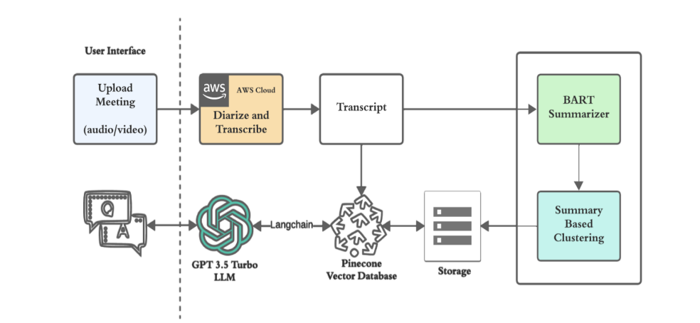
System Architecture

Slide 7
System Components
User Interface
Users upload audio or video meeting recordings
System processes files for diarization and transcription
AWS Cloud Processing
AWS Transcribe converts speech to text
Speaker diarization differentiates speakers
BART Summarizer
Facebook BART-based model creates abstractive summaries
Condenses lengthy meetings into key insights

Slide 8
System Components
Summary-Based Clustering
OpenAI embeddings with Semantic Graph smoothing refine contextual relationships
Mean-Shift clustering enables dynamic grouping based on content similarity
Smoothing embeddings improves differentiation between similar summaries
Pinecone Vector Database
Stores full transcripts as vector embeddings
Enables fast, efficient semantic search
LLM and Langchain
Langchain manages LLM memory
Processes user queries with Pinecone results
Generates answers using custom prompts

Slide 9
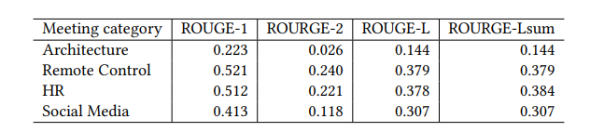
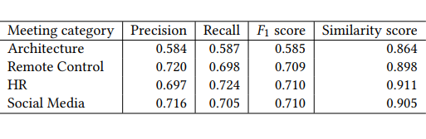
Abstractive Summarization
LLM Model : Facebook BART
Evaluation Metrics:
ROUGE: Measures overlap between generated and reference summaries using unigram (ROUGE-1), bigram (ROUGE-2), and longest common subsequence (ROUGE-L).
BERTScore: Evaluates semantic similarity using BERT embeddings and cosine similarity, providing precision, recall, and F1 scores. Unlike ROUGE, which focuses on exact word matches, BERTScore incorporates semantic understanding and context, making it more effective for abstractive summarization models like BART.

Slide 10
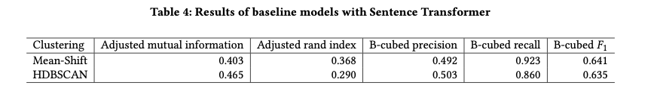
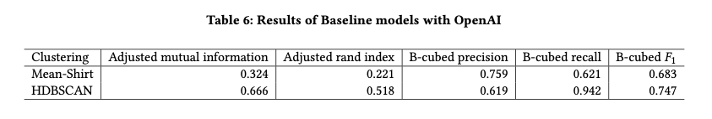
Clustering
Baseline Algorithms:
Mean shift
HDBSCAN
Vector Embedding:
Sentence Transformer
OpenAI.
Performance evaluated with:
Baseline clustering models (without smoothing)
smoothing + clustering models

Slide 11
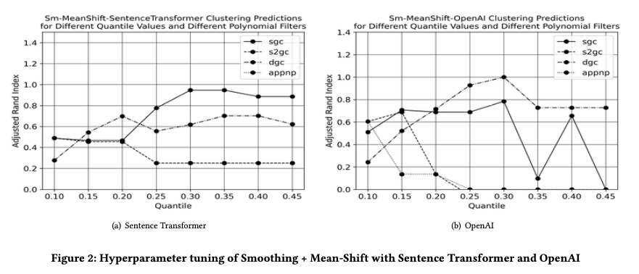
Clustering

Slide 12
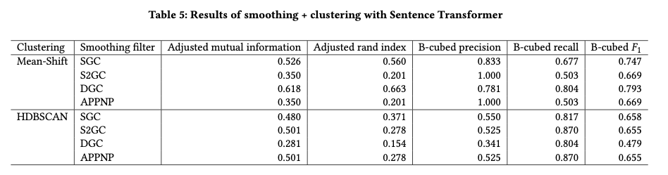
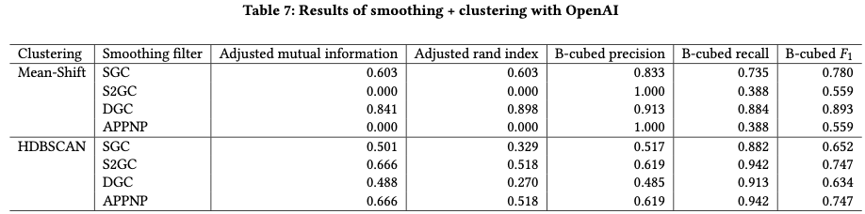
Clustering
While Mean-Shift with the S2GC and APPNP filters shows lower ARI, other models exhibit significant improvements particularly in ARI scores.
This suggests that OpenAI embeddings contribute to forming more robust and accurate clustering models

Slide 13
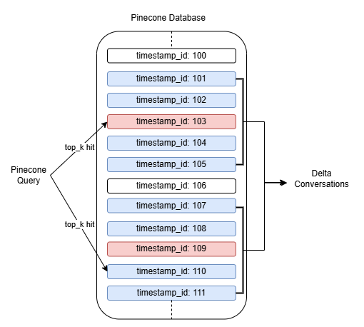
Vector Store data fetch strategy
Chunk-Based Storage: Conversations are stored as individual, searchable chunks in a vector database for efficient retrieval.
Challenge of Isolated Context: Transcripts require sequential understanding—retrieving only top_k hits returns fragmented snippets, missing surrounding dialogue.
Two-Phase Retrieval Strategy:
Phase 1: Identify the most relevant conversation IDs using top_k=10.
Phase 2: Execute a context-expansion query with a delta=2 to fetch 2 preceding and 2 succeeding chunks around each hit.
Dynamic Context Capture: The delta ensures seamless inclusion of adjacent conversation segments, preserving natural flow and dependencies.
Enhanced LLM Performance: Enriched context enables the model to generate more accurate, coherent, and context-aware responses.

Slide 14
LLM Re-Training
Goal: The primary aim of LLM retraining was to make the model more verbose, context-aware and add a character in its responses.
Custom Dataset: We created a tailored dataset consisting of 100 question-answer pairs with detailed, verbose answers to give the LLM a distinct personality.
Fine-Tuning Process: The meta-llama/Llama-2-7b-chat-hf model was fine-tuned using instruction-based training in float16 precision, leveraging Microsoft DeepSpeed.
Training Environment: The fine-tuning process was executed on an AWS EC2 instance with A100 GPU.

Slide 15
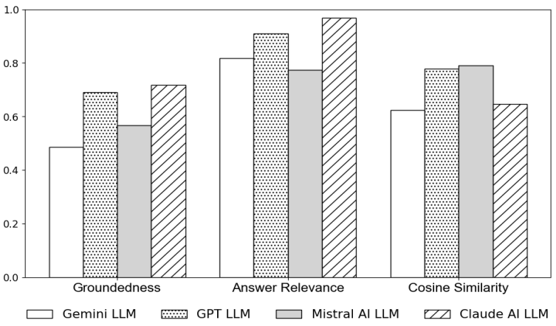
RAG Modelling Evaluation
Groundedness:
0 to 1
Measure of how well the answer is supported by the context.
Answer Relevance:
0 to 1
Measure of how well the answer is relevant to the question.
Context Relevance:
0 to 1
Measure of how well the context fetched from DB is relevant to the question.
Cosine Similarity
0 to 1
Measures how similar two strings are.

Slide 16
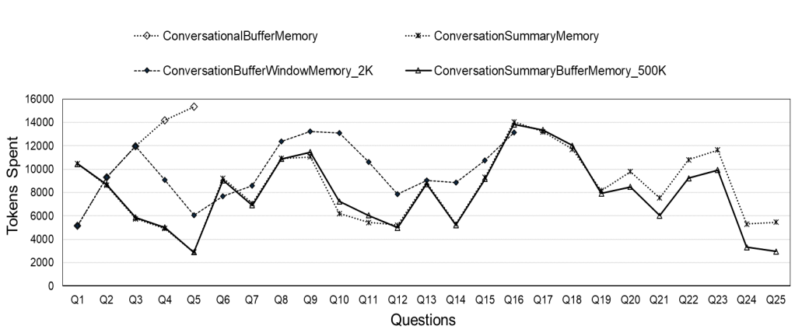
Comparing LLM Memory
ConversationalBufferMemory: Stores all interactions in sequence within the memory buffer.
ConversationalBufferWindowMemory: Stores only the last n interactions in the memory buffer.
ConversationalSummaryMemory: Stores a condensed summary of past interactions, capturing key details to maintain context and improve continuity
ConversationSummaryBufferMemory: Summarizes the message history into n tokens and stores the summary in the memory buffer.
We found that ConversationSummaryBufferMemory effectively mitigates the risk of exceeding the LLM’s token limit by summarizing previous interactions.
Thus, we adopted it with a 650-token summary.

Slide 17
Future Work
Performing QLoRA finetune on the model to improve model responses.
01
Using a better conversation diarization method.
02
Capturing and storing image screenshots from video meeting and tagging them to the conversation.
03
Using a multimodal model and ingesting documents to add more data to RAG.
04

Slide 18
Conclusion
Proposed Framework:
We introduce a Retrieval-Augmented Generation (RAG) framework combined with a finetuned model to efficiently manage and extract valuable insights from past meetings.
Enhanced Retrieval Mechanism:
By fetching relevant conversation chunks, we enrich the LLM’s context, improving response quality and relevance.
Optimized Memory Management:
Implementing ConversationSummaryBufferMemory with a 650-token limit ensures an optimal balance between memory efficiency and context retention.

Slide 19
Thank you!

Slide 20
Acknowledgements
This work was supported in part by United Arab Emirates University under UAEU-NFRP Grant No. G00004281 form United Arab Emirates University, and in part by Seattle University under Bannan Endowed Chair of Engineering Award.

